Slide 1
Updated guidelines in septic shock
Philippe Montravers
Anaesthesia and Surgical ICU,
CHU Bichat Claude Bernard,
Assistance Publique Hopitaux de Paris,
University Paris VII Denis Diderot
France

Slide 2
Disclosure
No conflict of interest

Slide 3
Global estimates of hospital treated sepsis cases/year 30.7 millions
Fleischmann C et al. Am J Respir Crit Care Med 2016;193:259-72
Global estimates of $ 20 billions (5.2%) of total US hospital costs
Torio CM et Andrews RM. http://www.ncbi.nlm.nih.gov/books/NBK169005/.

Slide 4
Sepsis a « fashionable » topic
Septic shock
NCBI NLM
PubMed
1955-2015:
28,842 citations
Severe sepsis
1955-2015:
143,546 citations

Slide 5

Septic shock
The visible part of the host response
to infection

Slide 6
The initial definitions of sepsis
Merriam-Webster Dictionary:
a definition is
“ a statement expressing the essential nature of something”
or, more simply
“ what something is”
However, we don’t precisely know
what is sepsis and septic shock

Slide 7
Infection:
Pathological process caused by invasion of normally sterile tissue, fluid or body cavity by pathogenic or a potentially pathogenic agent :
bacteria, fungus, virus
Bacteremia: Presence of bacteria in blood samples
Viremia virus
Fongemia fungi
Parasitemia parasite
Bone RC et al. Chest 1992;101:1644-55
Levy MM et al. Crit Care Med 2003; 31: 1250–56.

Slide 8
The initial definitions of sepsis
Bone RC et al. Chest 1992;101:1644-55
No Authors. Crit Care Med. 1992; 20:864-74.
Sepsis results from a host’s systemic inflammatory response syndrome (SIRS) to infection

Slide 9
The clinical definitions of sepsis
Bone RC et al. Chest 1992;101:1644-55
No Authors. Crit Care Med. 1992; 20:864-74.

Slide 10
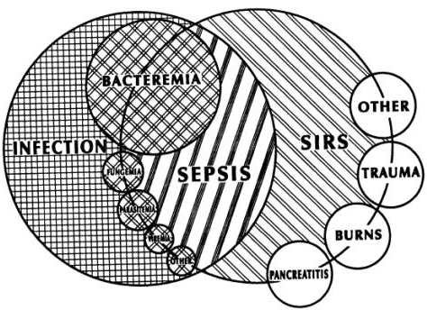
Interrelationship between SIRS and infection
BACTEREMIA
FUNGEMIA
PARASITEMIA
VIREMIA
Bone RC et al. Chest 1992;101:1644-55

Slide 11

Notes:
16

Slide 12
Sequential Sepsis-Related Organ Failure Assessment Score
SOFA score
Vincent JL et al. Intensive Care Med 1996; 22: 707–10

Slide 13
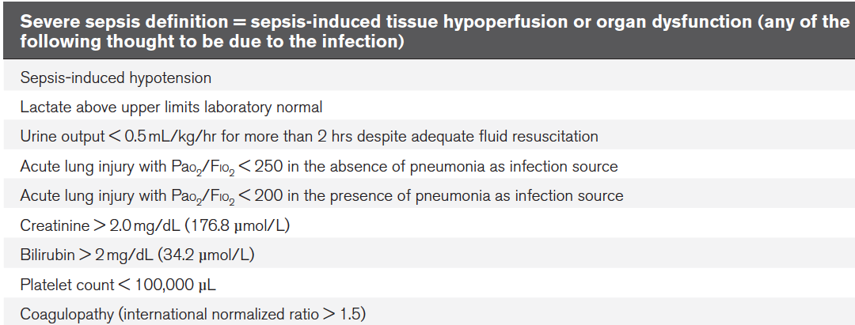
The second definitions of septic shock
Levy MM et al. Crit Care Med 2003; 31: 1250–56.

Slide 14
The second definitions of septic shock
Septic shock = State of acute circulatory failure
Persistent arterial hypotension unexplained by other causes of hypotension
  Systolic arterial pressure below 90 mmHg
  Or
  Mean arterial pressure < 60 mmHg
  or
  Reduction in systolic blood pressure >40 mmHg from baseline
Despite adequate volume resuscitation
In the absence of other cause of hypotension
Levy MM et al. Crit Care Med 2003; 31: 1250–56.

Slide 15
Predisposing factors, infection, response, organ dysfunction
The PIRO Classification model
Levy MM et al. Crit Care Med 2003; 31: 1250–56.

Slide 16
2003-4
Dellinger RP et al. Crit Care Med 2004;32:858-73
Dellinger RP et al. Crit Care Med 2008;36:296-327
Dellinger RP et al. Crit Care Med 2013;41:580-637

Slide 17
Different severities of sepsis and associated changes in clinical signs
Vincent JL et al. Lancet Respir Med 2016; 4:237-40

Slide 18
Importance of unexplained organ dysfunction in the diagnosis of sepsis
In clinical situations, sepsis is more frequently identified by the presence of unexplained organ dysfunction than by the presence of infection
Vincent JL et al. Lancet Respir Med 2016; 4:237-40

Slide 19
Key message from 2012 SSC guidelines
As soon as sepsis is evocated time matters
Dellinger RP et al. Crit Care Med 2013;41:580-637

Slide 20
Patients from 172 intensive care units in Australia and New Zealand (2000-13)
109,663 Patients with infection and organ failure
87.9% had SIRS-positive severe sepsis (≥2 SIRS criteria)
12.1% had SIRS-negative severe sepsis (<2 SIRS criteria)
Mortality increased linearly with each additional SIRS criterion
(odds ratio for each additional criterion, 1.13; 95% CI, 1.11 to 1.15; P<0.001)
without any transitional increase in risk at a threshold of two SIRS criteria
Kaukonen KM et al. N Engl J Med 2015;372:1629-1638

Slide 21
Over the past two decades, sepsis has been defined for clinical care several times.
Singer M et al. JAMA. 2016;315(8):801-810

Slide 22
Shortcut for rapid identification
Bad outcome is more common among infected patients who are septic than those who are not
No gold standard
for sepsis
Singer M et al. JAMA. 2016;315(8):801-810

Slide 23
Sequential Sepsis-Related Organ Failure Assessment Score
SOFA score
Singer M et al. JAMA. 2016;315(8):801-810

Slide 24
Quick SOFA
qSOFA as an alarm signal
To identify patients with suspected infection who are at greater risk for a poor outcome outside the ICU
Singer M et al. JAMA. 2016;315(8):801-810
qSOFA does not define sepsis (but the presence of two qSOFA criteria is a predictor of both increased mortality and ICU stays of more than three days in non-ICU patients)

Slide 25
Assessment of criteria
Prediction of in-hospital mortality
SOFA and LODS superior
in the ICU
qSOFA similar to complex scores outside the ICU
Seymour C W et al. JAMA. 2016;315(8):762-74

Slide 26
Summary of the new definitions of septic shock
SIRS is no longer criterion for sepsis
  SIRS criteria were unhelpful and misleading
SIRS is replaced with qSOFA score
  Fast and easy tool to help identify sepsis
  qSOFA does not require laboratory tests
SOFA score is now used to clinically characterize septic patients
  SOFA is superior to SIRS in predicting hospital mortality, with a SOFA score ≥2 identifying a 2- to 25-fold increased risk of dying
Severe sepsis is no more
  As the definition of sepsis requires life-threatening organ dysfunction, the categorization of “severe sepsis” has been deemed superfluous and unnecessary
Lactate is part of septic shock criteria, along with resistant hypotension
  Fluid resistant hypotension and a lactate >2 mmol/L is superior in predicting mortality than either marker alone
  A patient MUST have both hypotension (MAP< 65) and a lactate >2 mmol/L despite adequate fluid resuscitation

Slide 27
Implications of the New Definitions for Screening and Management
Massimo Antonelli, MD
Daniel DeBacker, MD, PhD
Todd Dorman, MD, FCCM
Ruth Kleinpell, RN-CS, PhD, FCCM
Mitchell Levy, MD, MCCM
Andrew Rhodes, FRCP, FRCA, FFICM
http://www.survivingsepsis.org/SiteCollectionDocuments/SSC-Statements-Sepsis-Definitions-3-2016.pdf

Slide 28
Implications of the New Definitions for Screening and Management
Step 1: Screening and Management of Infection
Hospitals should continue to use signs and symptoms of infection to promote the early identification of patients with suspected or confirmed infection
http://www.survivingsepsis.org/SiteCollectionDocuments/SSC-Statements-Sepsis-Definitions-3-2016.pdf

Slide 29
Implications of the New Definitions for Screening and Management
Step 2: Screening for Organ Dysfunction and Management of Sepsis
Patients with sepsis should still be identified by the same organ dysfunction criteria (including lactate level greater than 2 mmol/L).
Organ dysfunction may also be identified in the future using the quick Sepsis-Related Organ Failure Assessment (qSOFA)
Evidence of two out of three qSOFA elements may be used as a secondary screen to identify patients at risk for clinical deterioration.
If organ dysfunction is identified,
ensuring that the three-hour bundle elements have been initiated continues to be a priority
http://www.survivingsepsis.org/SiteCollectionDocuments/SSC-Statements-Sepsis-Definitions-3-2016.pdf

Slide 30
Implications of the New Definitions for Screening and Management
Step 3: Identification and Management of Initial Hypotension
In those patients who have infection and hypotension or a lactate level ≥4 mmol/L
providing 30 mL/kg crystalloid with reassessment of volume responsiveness or tissue perfusion should be implemented.
The six-hour elements of care should be completed.
For the six-hour bundle, repeat lactate level is recommended if initial lactate level was >2 mmol/L.
http://www.survivingsepsis.org/SiteCollectionDocuments/SSC-Statements-Sepsis-Definitions-3-2016.pdf

Slide 31
In summary
The new definitions do not change
the primary focus of early sepsis identification
initiation of timely treatment
fluid loading
vasoactive agents
antibiotic agents/source control

Slide 32
In summary
The new definitions improve
Early identification of patients outside the ICU
Initiation of timely treatment outside the ICU

