Slide 1
THÔNG KHÍ NHÂN TẠO VỚI VT THẤP TRÊN BỆNH NHÂN KHÔNG CÓ ards
TS. ĐỖ NGỌC SƠN
KHOA CẤP CỨU – BỆNH VIỆN BẠCH MAI

Slide 2
NỘI DUNG
Vt thấp là chỉ dấu của chiến lược bảo vệ phổi
Cơ sở bằng chứng của Vt thấp trên bệnh nhân không có ARDS

Slide 3
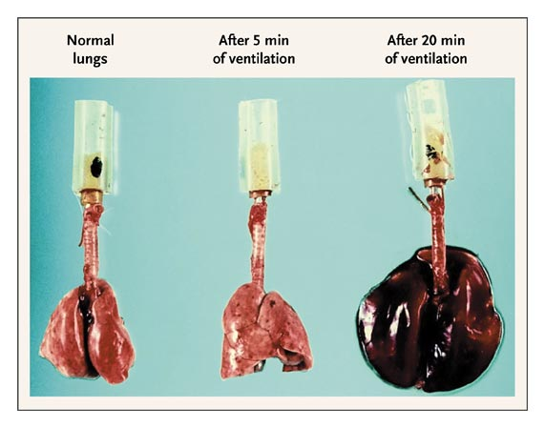
Thể tích lưu thông thấp là chỉ dấu của chiến lược bảo vệ phổi

Slide 4
Thể tích lưu thông thấp là chỉ dấu của chiến lược bảo vệ phổi
Vt = 6mL/kg cân nặng lý tưởng (so với 12mL/kg CNLT)
AL Plateau </= 30
Cải thiện tỷ lệ TV từ 39.8% xuống 31.0%

Slide 5

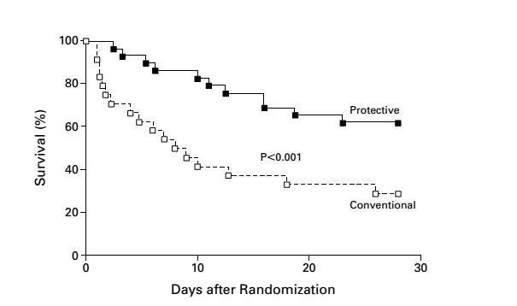
  TL TV và biến chứng còn cao: 30 - 40%

Slide 7
Notes:
Values are represented as total numbers with (%) aThe ventilation parameters collected and are median (IQR) values
Fig 1 The difference between the actual delivered tidal volume and the ideal tidal volume based on predicted weight in the whole cohort of patients within the study. The boxes represent the median and IQR and the whiskers the minimum and maximum values. The p value is from a Wilcoxon signed rank test

Slide 8
Notes:
Values represent the median (IQR) ASA American Society of Anesthesiology, BMI body mass index, pPeak peak pressure, PEEP positive end expiratory pressure, FiO2 fraction of inspired oxygen aThe difference between actual and the ideal tidal volumes (TV) was significant for all comparisons in all groups, p < 0.001 using a Wilcoxon signed rank test bA Kruskal-Wallis test between the various BMI categories, where p < 0.0001. Dunn’s post hoc test demonstrated that the pPeak between each group was significantly different (p < 0.05) for each comparison
Fig 2 The tidal volume delivered based on actual weight (ml/kg) and peak pressure (pPeak) in patients categorized by their body mass index (BMI). The boxes represent the median and IQR and the whiskers the minimum and maximum values. a The tidal volumes (ml/kg). A Kruskal-Wallis test was significant (p < 0.001) with Dunn’s post hoc test demonstrating significant differences in between all comparisons. b The peak pressure (cmH2O). A Kruskal-Wallis test was significant (p < 0.001) with Dunn’s post hoc test demonstrating significant differences in between all comparisons.

Slide 10
Notes:
Figure 1 Time course of plasma TNF-a (top) and IL-8 (bottom) levels in high tidal volume (High VT) and low tidal volume (Low VT)
Groups.
Figure 2 Time course of logarithmic standardized-urea bronchoalveolar lavage (Log BAL-urea) TNF-a (top) and IL-8 (bottom) levels.
There were no differences between groups at baseline.

Slide 12
Ảnh hưởng của peep và thể tích lưu thông đến tổn thương phổi
Notes:
Alveolar stability in the control and Tween-injured lung. In the phase I protocol alveolar stability (I-EΔ) was determined for all nine combinations of tidal volume (Vt) and positive end-expiratory pressure (PEEP). (a) Note very stable alveoli (low I-EΔ), regardless of PEEP and Vt, in normal lungs before endotracheal instillation of Tween (Additional file 1). (b) After Tween instillation, ventilation with the highest Vt (15 cc/kg) combined with the lowest PEEP (5 cmH2O) caused the greatest alveolar instability (highest I-EΔ; Additional file 2), whereas ventilation with the lowest tidal volume (6 cc/kg) and highest PEEP (20 cmH2O) resulted in the most stable alveoli (lowest I-EΔ). *The two Vt/PEEP combinations selected for use in the 3-hour ventilator-induced lung
injury protocol (phase II).

Slide 13
Ảnh hưởng của peep và thể tích lưu thông đến tổn thương phổi
Notes:
Number of alveoli per microscopic field and alveolar stability over time. In the phase II protocol alveolar microatelectasis and alveolar stability were evaluated. (a) Alveolar microatelectasis was measured by counting the number of alveoli per in vivo microscopic field; (b) alveolar stability was measured as the percentage change in alveolar area from inspiration to expiration (I-E%). Measurements were made before endotracheal instillation of Tween (Baseline), after endotracheal instillation of Tween (Post-Tween), and every 30 min thereafter for 180 minutes. PEEP, positive end-expiratory pressure; Vt, tidal volume.

Slide 15
Notes:
Pathology in th the high Vt/low PEEP and low Vt/high PEEP groups. Representative lung histology from the (a) high tidal volume (Vt)/low positive endexpiratory pressure (PEEP) and the (b) low Vt/high PEEP groups. Morphometric Lung Injury Scores and wet:dry weight ratio are also shown. High
Vt/low PEEP caused thickened alveolar walls, numerous neutrophils, and significant intra-alveolar edema. Low Vt/high PEEP ventilation significantly
decreased all of the histologic indices of lung injury as compared with the high Vt/low PEEP group. Lung wet:dry weight ratios were not different
between groups. Data are expressed as mean ± standard error. *P < 0.05 versus high Vt/Low PEEP group.

Slide 16
Vt thấp và chỉ dấu của tổn thương phế nang

Slide 17
Vt thấp và chỉ dấu của tổn thương phế nang
sRAGE: soluble receptor for
advanced glycation end-products
Jabaudon M. et al., Association between intraoperative ventilator settings and plasma levels of soluble receptor for advanced glycation end-products in patients without pre-existing lung injury. Respirology (2015) 20, 1131–1138

Slide 18
Thử nghiệm IMPROVE trong phẫu thuật bụng
Nghiên cứu đa trung tâm, mù đơn nhóm song song
400 bệnh nhân trưởng thanh có nguy cơ trung bình hoặc cao sau phẫu thuật bụng
Thông khí bảo vệ phổi vs. thường quy
Kết cục chính là biến chứng lớn tại phổi hoặc ngoài phổi trong 7 ngày đàu sau phẫu thuật.
Notes:
Figure 1. Assessment, Randomization, and Follow-up of Patients.
A total of 1803 patients awaiting abdominal surgery were assessed preoperatively for trial eligibility by the research staff. A total of 400 patients were included in the modified intention-to-treat analysis and were followed for 30 days after surgery. After randomization, 3 patients were excluded; 2 patients were excluded because surgery was stopped prematurely (duration, <2 hours), owing to extensive illness, and 1 had undergone randomization in error. An additional 3 patients were then enrolled in the study.

Slide 19
Thử nghiệm IMPROVE trong phẫu thuật bụng
Notes:
Figure 2. Kaplan–Meier Estimates of the Probability of the Composite Primary Outcome.
Data for the Kaplan–Meier estimates of the probability of the composite primary outcome of major pulmonary or extrapulmonary complications were censored at 30 days after surgery. Major pulmonary complications included pneumonia or the need for invasive or noninvasive ventilation for acute respiratory failure. Major extrapulmonary complications were sepsis, severe sepsis, septic shock, and death. P<0.001 by the log-rank test for the between-group difference in the probability of the primary outcome.

Slide 21
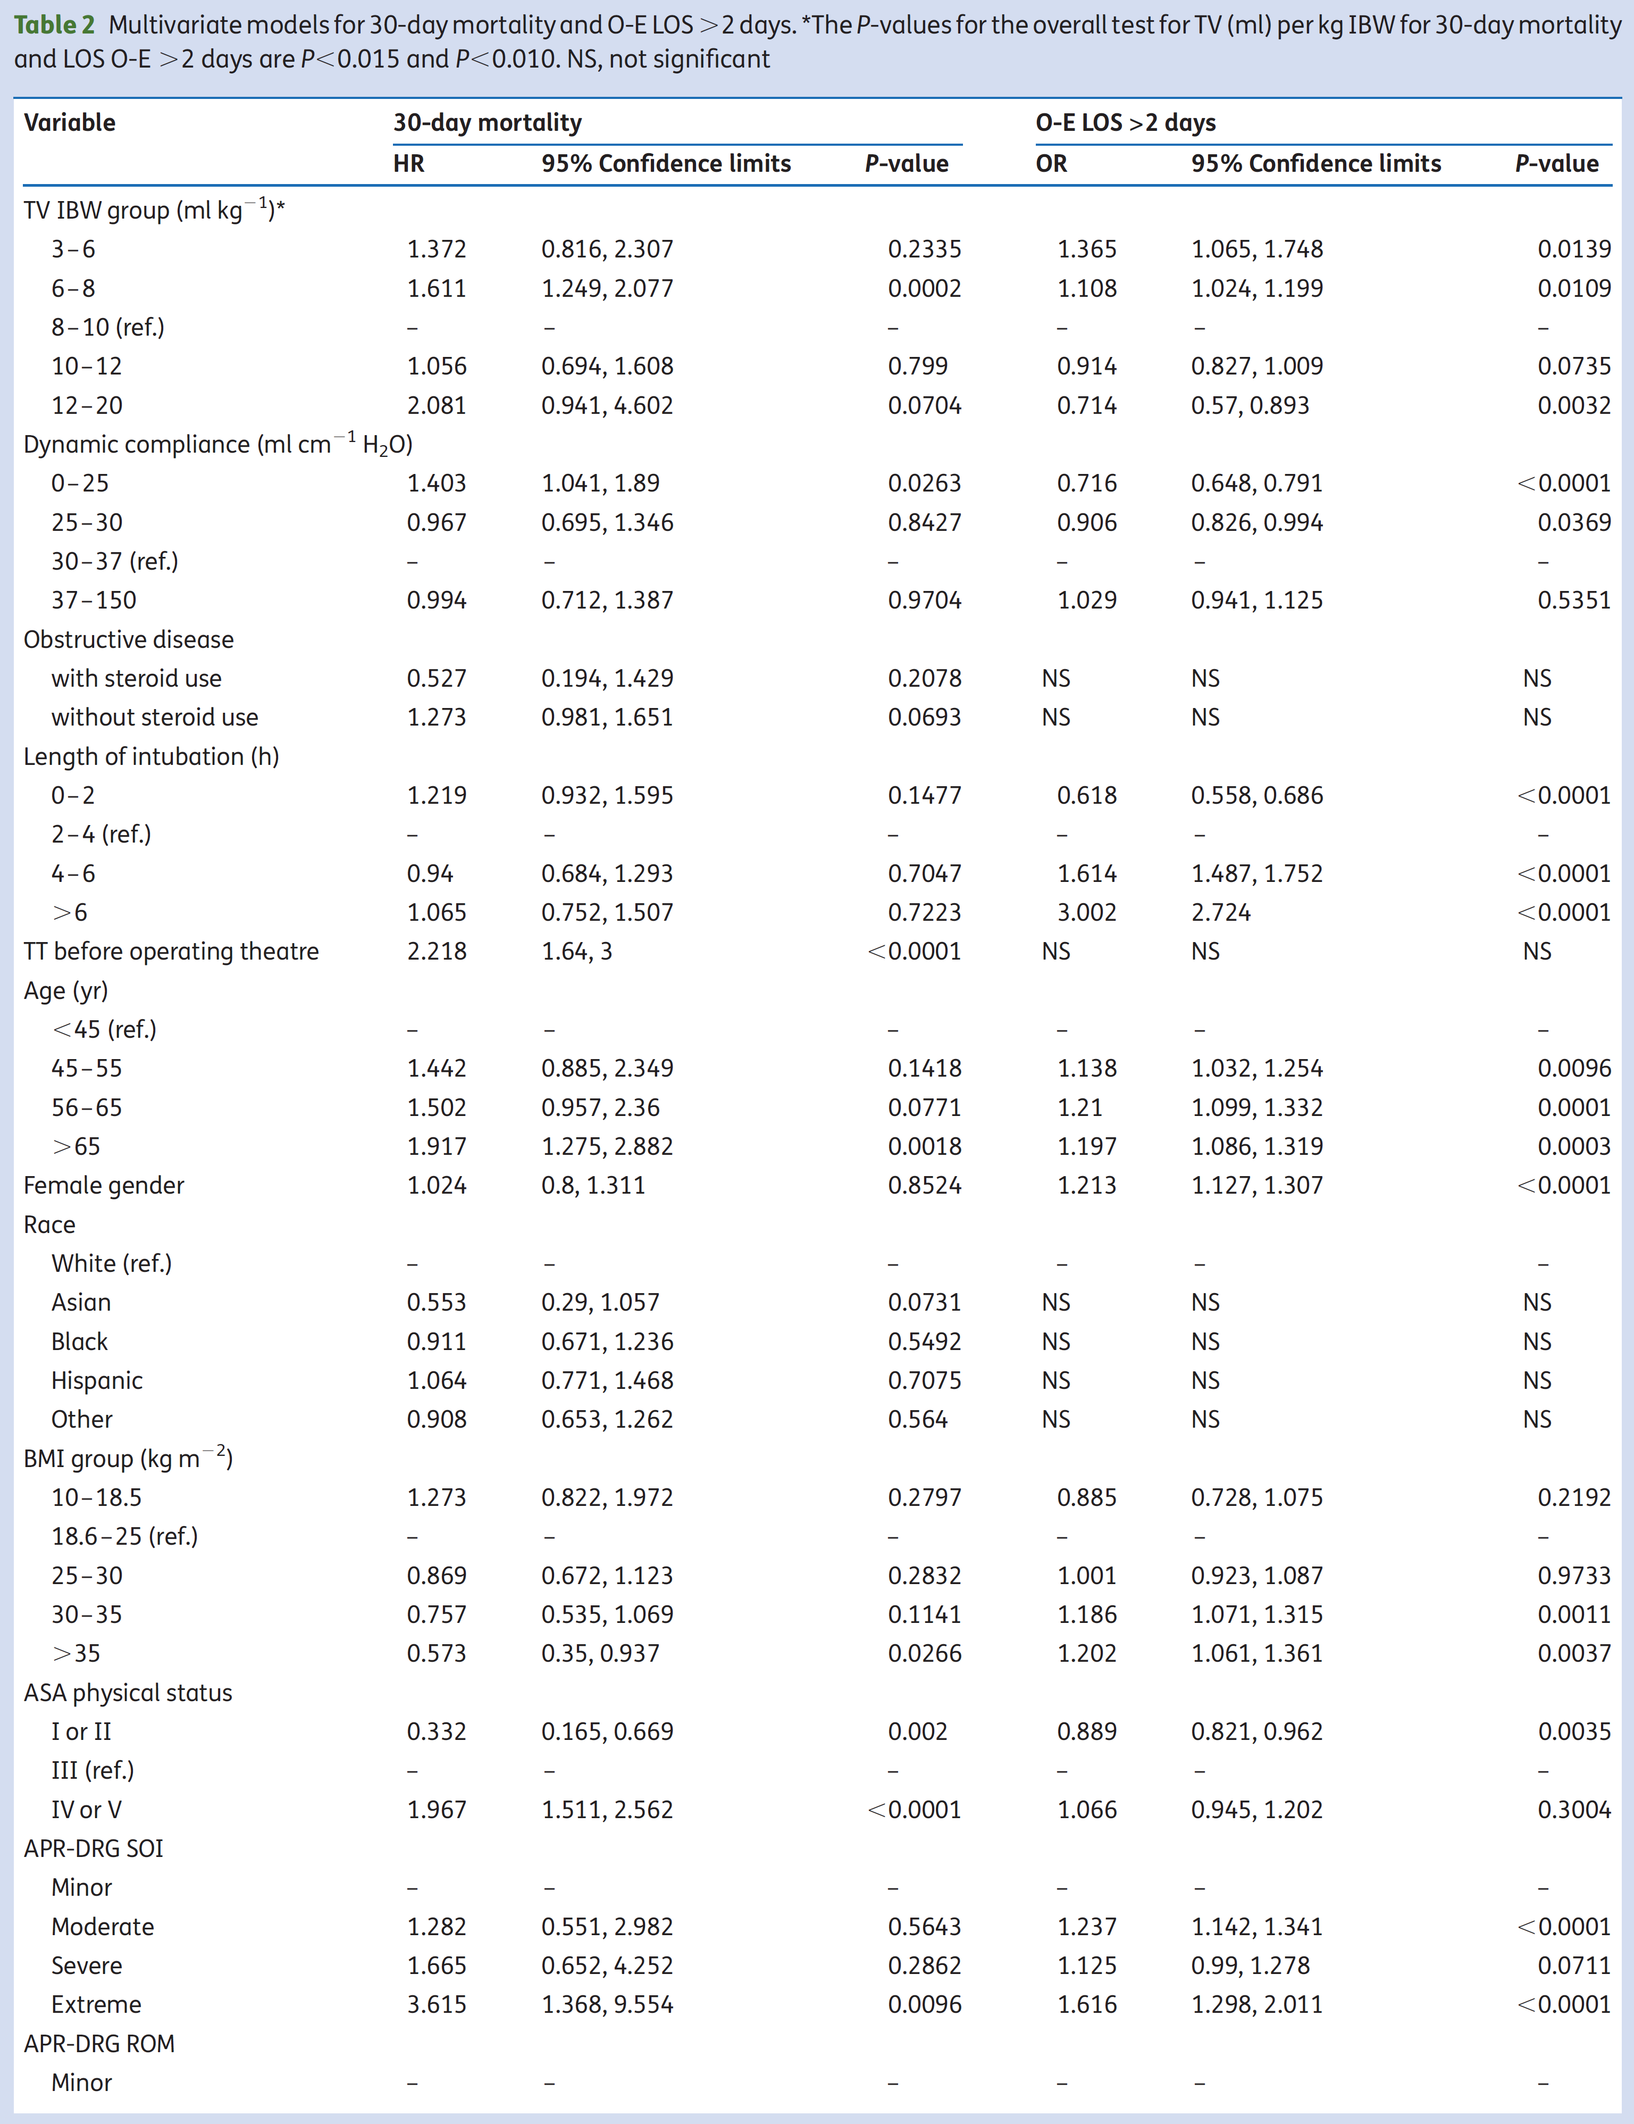

Slide 22
Notes:
Fig 3 The effect of intraoperative tidal volume on 30-day mortality. RCS curve showing the dose–response relationship between median TV per kg
IBW and 30-day mortality. Dots show the 5th, 50th, and 95th percentiles of TV per kg IBW. The shaded area shows the 95% CI. The CI .0.00 indicates
a significant association between TV per kg IBW ,9.7 ml kg21 and 30-day mortality.

Slide 26
Notes:
Figure 3 Forest plots showing the effect of protective ventilation on outcomes of new onset acute lung injury (ALI), pneumonia, atelectasis and other adverse outcomes. The results show that protective ventilation is protective against new onset ALI (OR 0.41, 95% CI 0.19 to 0.87) and other adverse outcomes (OR 0.67, 95% CI 0.48 to 0.93). The protective ventilation tends to reduce the risk of pneumonia and atelectasis, but statistical significance is not reached.

Slide 27
Notes:
Figure 4 Comparison of respiratory parameters between treatment and control groups. Protective ventilation induces higher oxygenation as compared with the control group (weighted mean difference (WMD) 17.79 mm Hg, 95% CI 7.99 to 27.60 mm Hg), but it results in more carbon dioxide retention (WMD 2.87, 95% 2.25 to 3.49 mm Hg). Alveolar-arterial oxygen gradient is not significantly different between groups. Finally, a lower pH value is found in the protective ventilation group (WMD −0.02, 95% −0.03 to −0.02 mm Hg), which is consistent with the carbon dioxide retention.

Slide 28
Notes:
Figure 5 Effect of protective ventilation on clinical outcomes. As shown in the figure, protective ventilation can significantly reduce the length of stay in hospital by 1 day as compared with conventional ventilation (weighted mean difference (WMD) −0.95, 95% CI −1.29 to −0.61 days). However, there is no evidence that protective ventilation can reduce the duration of mechanical ventilation, length of stay in the intensive care unit (ICU) and mortality rate.

Slide 29
Notes:
Figure 6 Publication bias assessed by funnel plot. Publication bias was assessed using the effect sizes of OR of acute lung
injury and weighted mean difference of carbon dioxide retention. The result showed that there was potential publication bias in
the present analysis as represented by the asymmetrical appearance of both plots. Egger’s tests were statistically significant for
both parameters (p=0.006 and 0.027, respectively).

Slide 30
Khuyến cáo
Thể tích lưu thông thấp 6-8 ml/kg IBW
Áp lực cao nguyên mức thấp nhất
PEEP 5 cmH2O và nên tăng trên bệnh nhân béo phì, tăng áp lực ổ bụng
Không nên tiến hành huy động phế nang trên phổi bình thường

