Slide 1
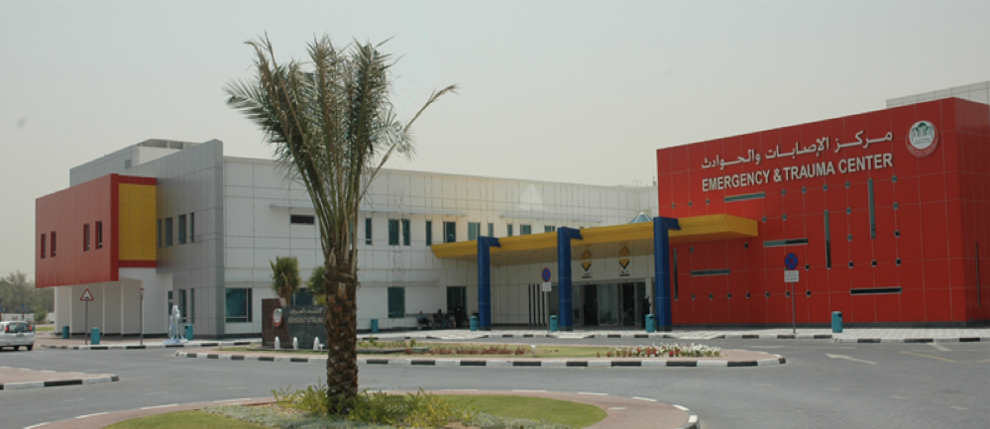
Chống đau sau phẫu thuật lồng ngực
Pain management for thoracic surgery
Philippe B. Macaire MD
Consultant in Anesthesiology and Pain Medicine
Rashid Hospital - Trauma Centre
Dubai Health Authority - UAE

Slide 2
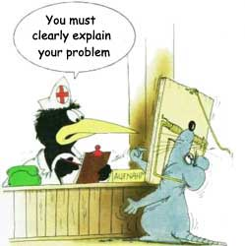
Thoracic surgery and pain
Innervation of thoracic wall
Analgesia techniques and outcomes
What are the trends?

Slide 3
It is very painful with a lot of chronic pain
No breast surgeries
Thoracic surgery and pain
Innervation of thoracic wall
Analgesia techniques and outcomes
What are the trends?
Complex
{
From neuraxial to more and more peripheral

Slide 4
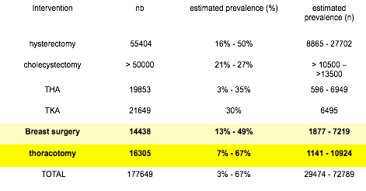
2000

Slide 5
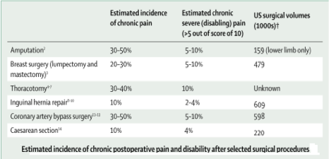
2006
Acute postoperative pain is followed by persistent pain in 10-50% of individuals after common operations, such as groin hernia repair, breast and thoracic surgery, leg amputation, and coronary artery bypass surgery. Since chronic pain can be severe in about 2-10% of these patients, persistent postsurgical pain represents a major, largely unrecognised clinical problem.

Slide 6
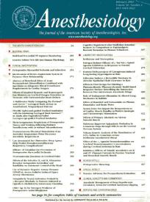
2000
following thoracotomy: 22-67%
following breast surgery : 11-57%
following cholecystectomy: 3-56%
following inguinal hernia repair : 0-37%
following limb amputation: 30-80%
Pain
Clinic
Acute
Persistant
Chronic

Slide 7
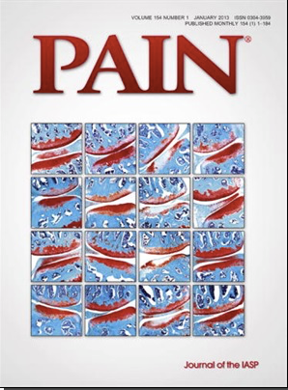
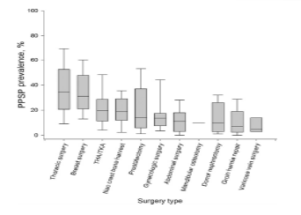
2013
Thoracic and breast surgeries

Slide 8
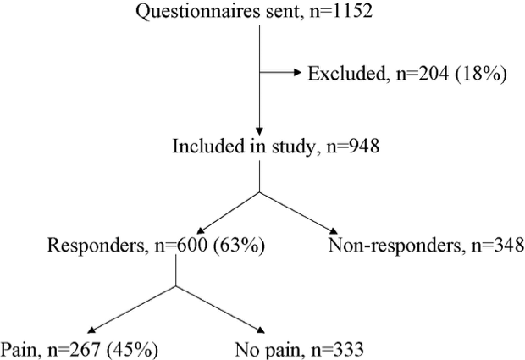
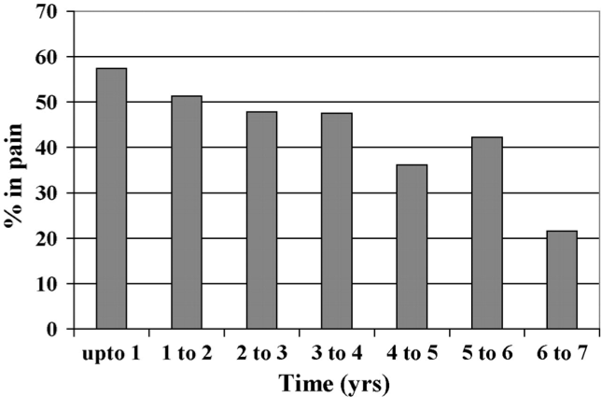
2006
The relationship between prevalence of pain and time since the operation.

Slide 9
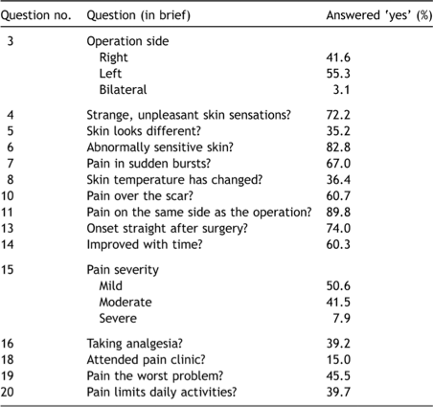
2006
Quality of Life

Slide 10
1999

Slide 11
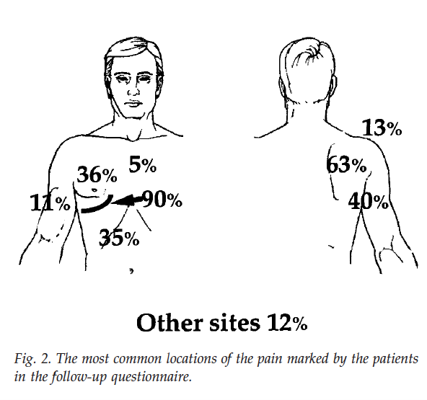
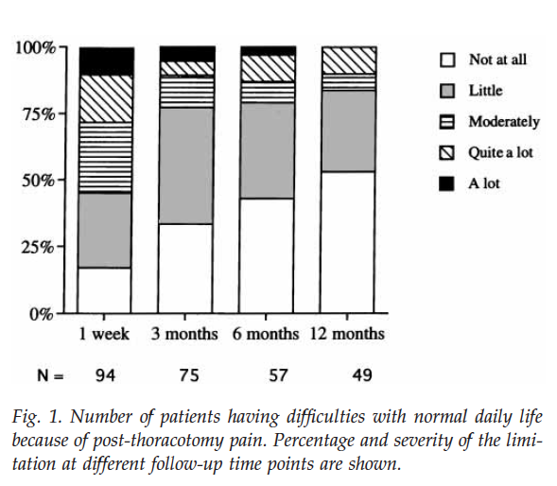
1999

Slide 12
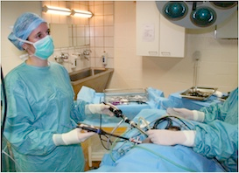
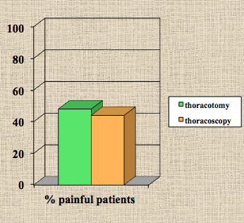
from :
Dajczman et al Chest 1991
Kalso et al Acta Anaesthesiol Scand 1992
Landreneau Thor Cardiovasc Surg 1994
Bertrand et al Ann Thor Surg 1996
Perttunen et al Acta Anaesthesiol Scand 1999
Obata et al Can J Anaesth 1999

Slide 13
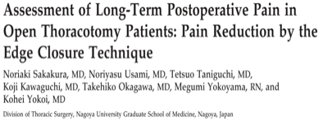
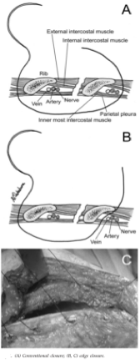
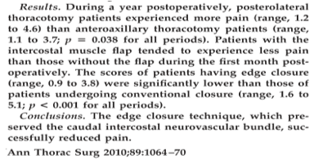
2010

Slide 14
2015
Any type of surgery can lead to persistent pain (Chronic Post-Surgical Pain, CPSP), including minor or less invasive procedures. CPSP often but not always includes neuropathic pain features; when a neuropathic component is present, CPSP is more severe. The major risk factors for the development of CPSP are well known but not selective. New tools to target high-risk patients preoperatively are currently being assessed (e.g. the risk index from Althaus and colleagues) but remains not specific enough. Today, the prevention of CPSP might be improved by a better management of the patients, specifically by a better control of severe acute postoperative pain (i.e. early diagnosis of a neuropathic component involved, judicious utilization of peri-operative opioid analgesics, use of pain trajectories to better assess postoperative pain resolution)

Slide 15
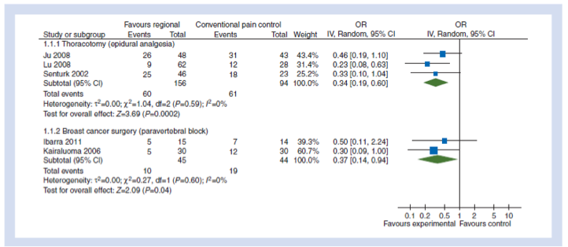
2013

Slide 16
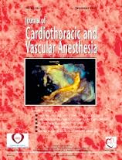
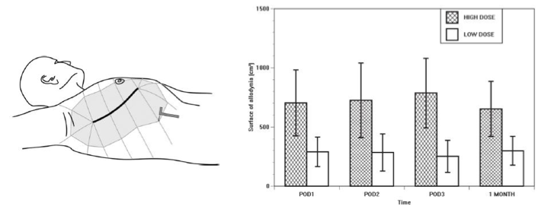
2010
Perform the regional analgesia before surgery

Slide 17
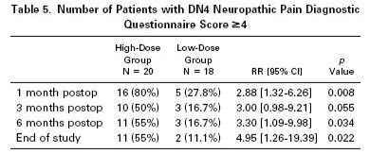
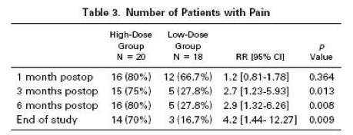
2010

Slide 18
Thoracic surgery and pain
Innervation of thoracic wall
Analgesia techniques and outcomes
What are the trends?

Slide 19
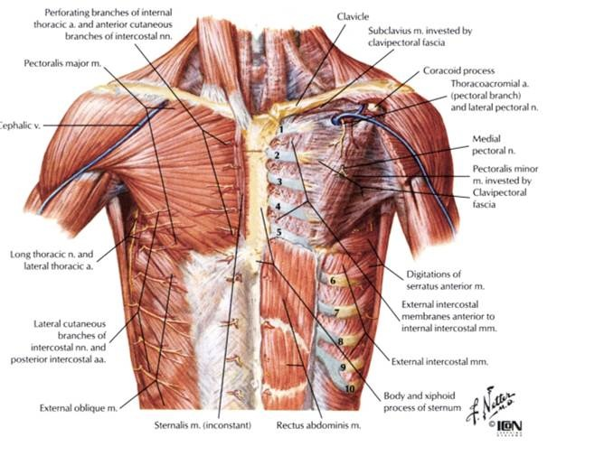
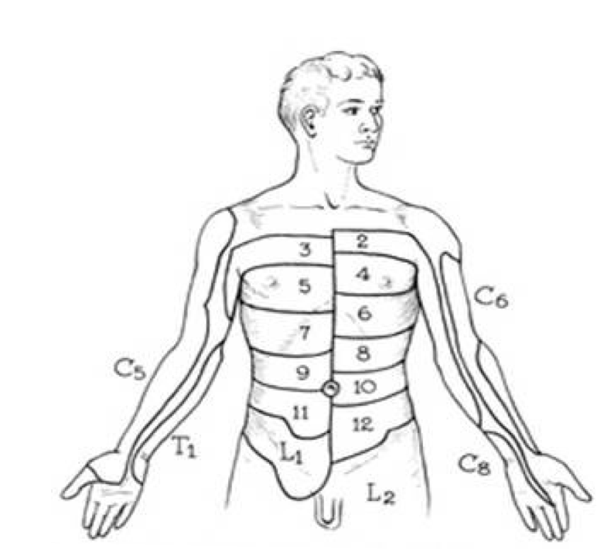
Innervation of the thoracic wall

Slide 20
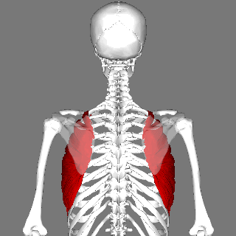
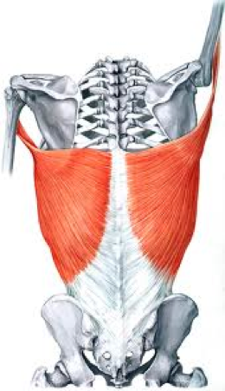
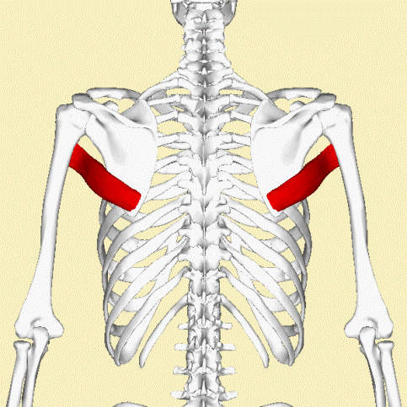
Innervation of the thoracic wall
Pectoralis Major M.
Lateral pectoral N.
Medial pectoral N.
Pectoralis Minor M.
Medial pectoral N
}
Superf cervical Plexus
Intercosto brachial N.
Serratus Ante. M.
Serratus Ante. M.
Serratus Ante. M.
Long thoracic N.
Latissimus Dorsal. M.
Thoraco dorsal N.
Terres major M.
Lower subscap. N.
+
Intercostal N. T2>11

Slide 21
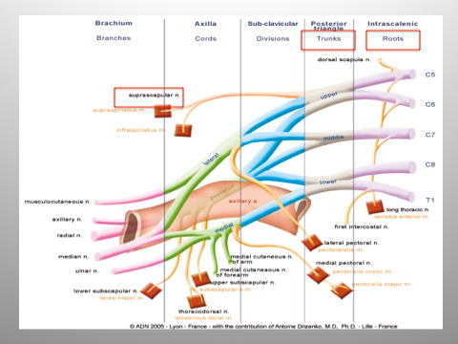
Innervation of the thoracic wall
Long thoracic N.
Lateral pectoral N.
Medial pectoral N.
Lower subscap. N.
Thoraco dorsal N.
Drizenko A. Professor of Anatomy and Anesthesiology - France

Slide 22
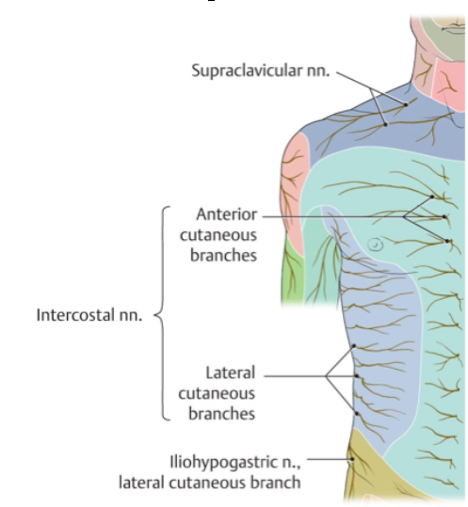
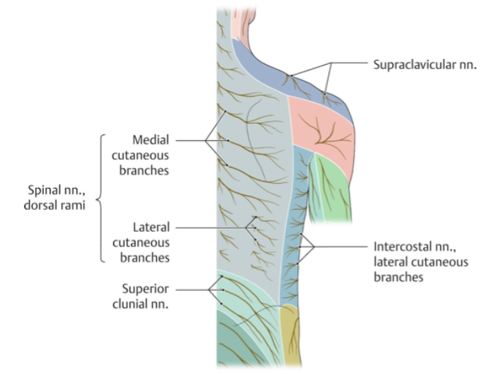
Where are these nerves ?
Spinal nerve
Ventral Ramus
Dorsal Ramus
Intercostal nerve

Slide 23
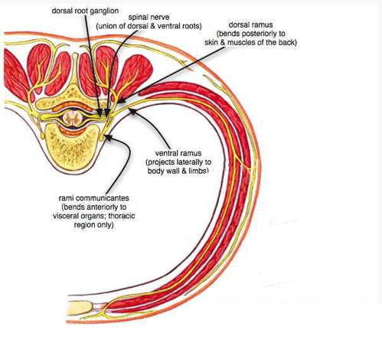
Where are these nerves ?
Spinal nerve
Ventral Ramus
Intercostal nerve
Ventral ramus
of
the spinal nerve
Lateral – pierces the intercostal muscles/serratus anterior in the mid axillary line to give off anterior and posterior cutaneous branches except at T2 -> Intercosto brachial nerve
Anterior – pierces the intercostal muscles and serratus anterior anteriorly to supply the medial breast.

Slide 24
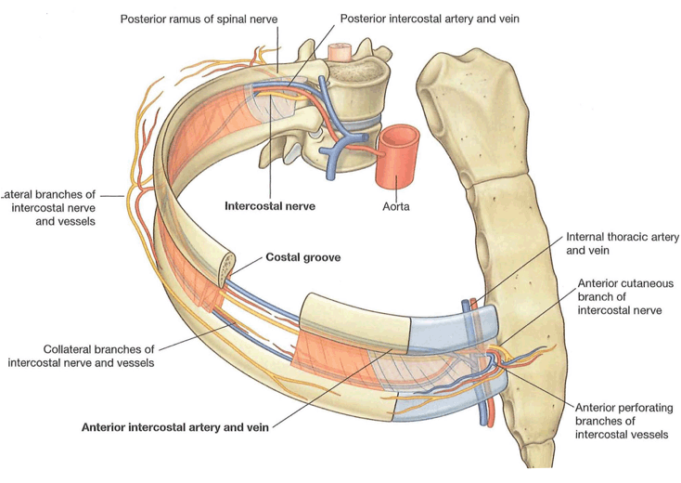
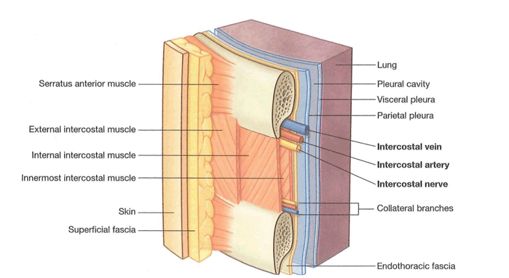
Where are these nerves ?

Slide 25
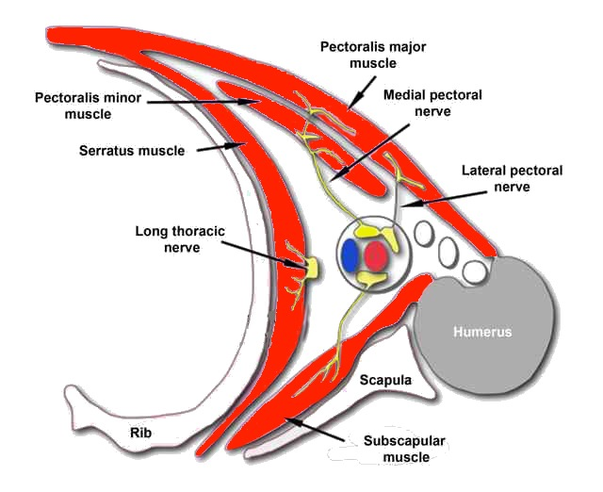
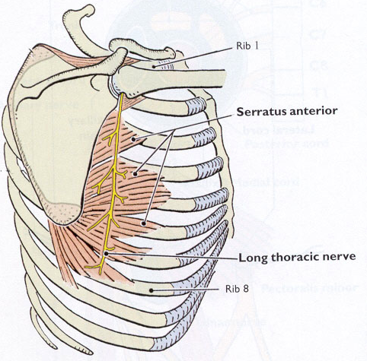
Where are these nerves ?
Medial pectoral nerve
Long thoracic nerve
Lateral pectoral nerve
Long thoracic nerve
Infra scapular nerve

Slide 26
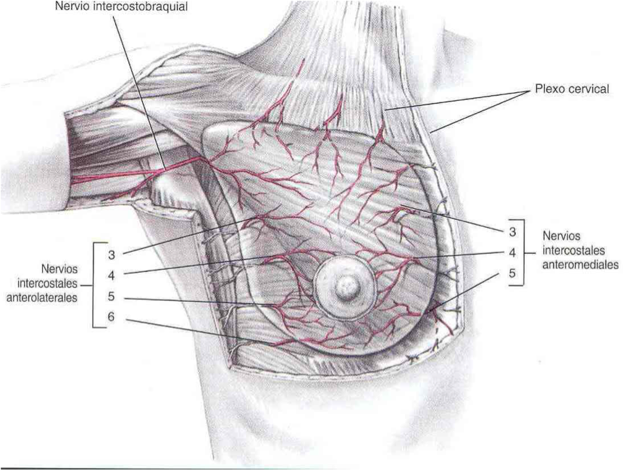
Innervation of the Breast
Intercosto brachial N.
Superf cervical Plexus
Intercostal nerve
anterior branch
Intercostal nerve
medial anterior cutaneous branch
Do not forget Pectoralis muscles

Slide 27
Innervation of the thoracic wall
Not ONLY INTERCOSTAL NERVES
Never forget the ortho sympathic fibers who could be the carriers of excessive pain with the arteries involved

Slide 28
Epidurale
Para-vertebral Block
Intercostal Block
Thoracic surgery and pain
Innervation of thoracic wall
Analgesia techniques and outcomes
What are the trends?

Slide 29
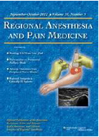
2012
“The number of indications for the use of epidural analgesia seems to be decreasing for a variety of reasons. The decision about whether to continue using epidural techniques should be guided by regular institutional audits and careful risk-benefit assessment rather than by tradition.
For routine postoperative analgesia, epidural analgesia may no longer be considered the gold standard.”

Slide 30
2016
Pain Rest and mob : Thoracic Epidural > Para-vertebral Block
Side effects : Para-vertebral Block >>> Thoracic Epidural
Mortality Morbidity : Para-vertebral Block >>> Thoracic Epidural
Para-vertebral Block

Slide 31
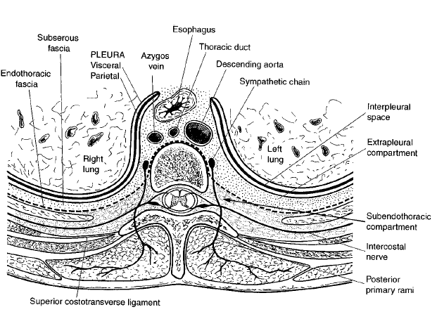
Paravertebral Block
2012
Karmakar M

Slide 32
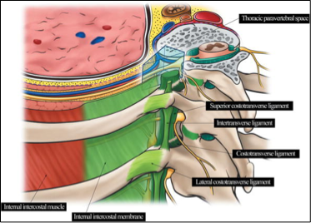
Paravertebral Block
2012
Para vertebral space
Karmakar M

Slide 33
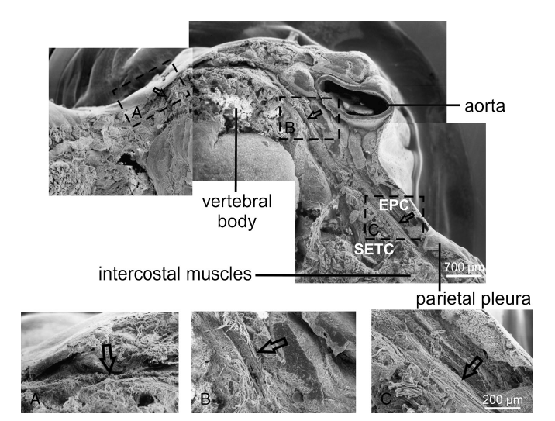
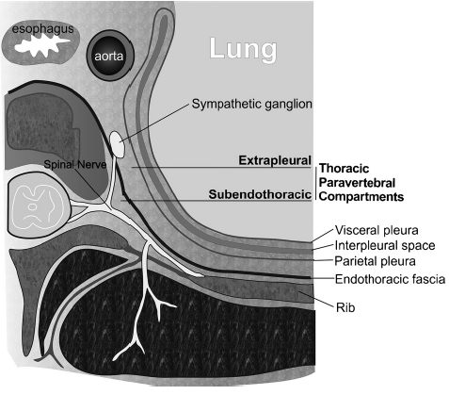
2012

Slide 34
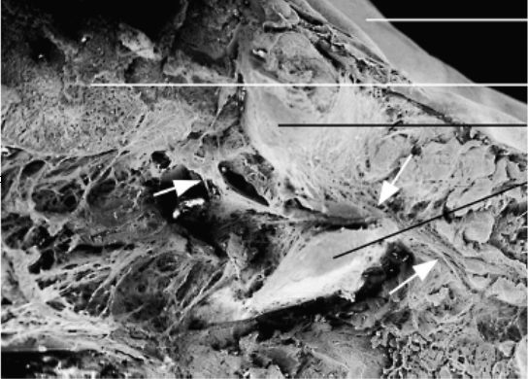
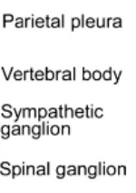
2012

Slide 35
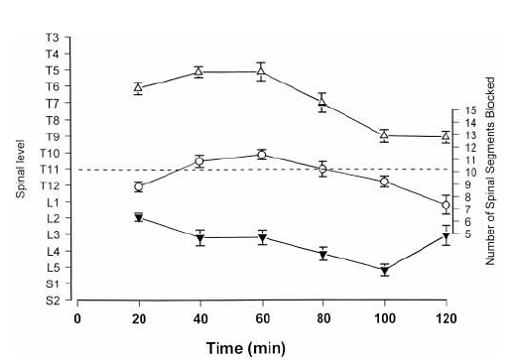
2001
22 mL right side >

Slide 36
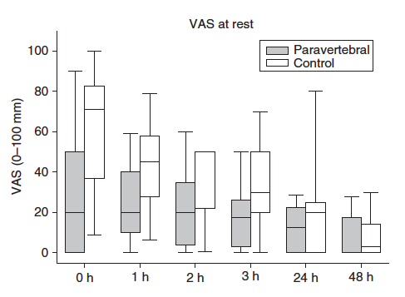
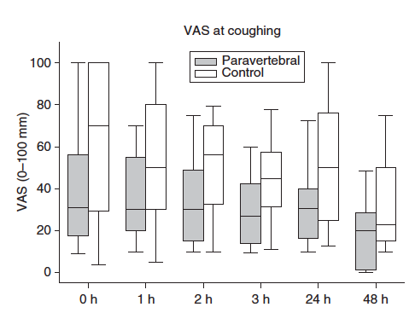
2005
PVB 0,4 mL/Kg

Slide 37
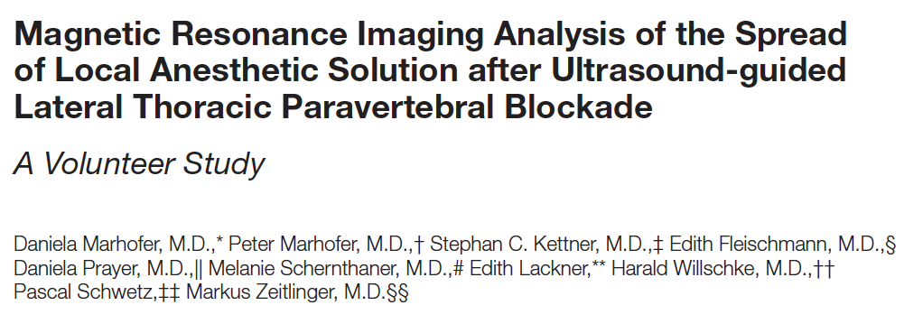
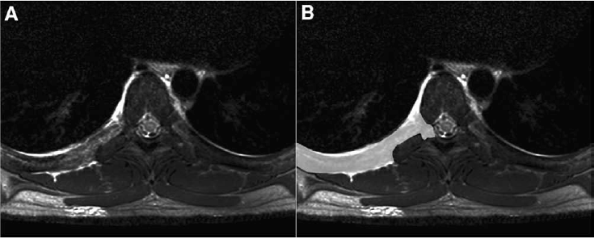
2013

Slide 38
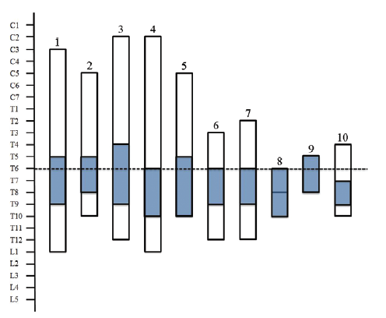
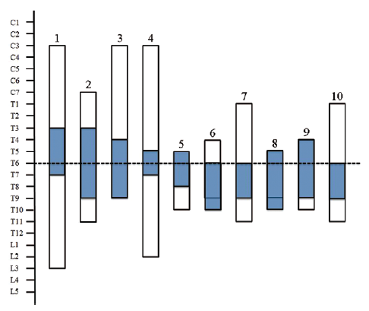
2013
Right
Left

Slide 39
2012
Surgery :
Video T7 + Post op Drain
Instruments T4 T5
Para V Block NS Technique:
S = 20 mL of LA T6
M = 4mL of LA T4 > T8

Slide 40
2012
Surgery :
Video T7 + Post op Drain
Instruments T4 T5
Para V Block NS Technique:
S = 20 mL of LA T6
M = 4mL of LA T4 > T8

Slide 41
2006
Bilateral PVB
0.36 mL/kg divided equaly / # inj / side
To cover 4 Levels
1st injection level above the incisional area Level 1
2nd injection incisional level = level 2
3rd and 4th Injection 1 levels bellow
3 groups of treatment:
1inj Level 1 vs 4 Inj levels 1,2,3&4
2 inj levels 1&3 vs 4 Inj. levels 1,2,3&4
3 inj levels 1,3&4 vs 4 Inj. levels 1,2,3&4

Slide 42
2006
% | 1 | 4
1 vs 4 | 11/44 | 100/100
2 vs 4 | 30/83 | 96/100
3 vs 4 | 65/90 | 95/100
1 | 4
0/0 | 11/39
4/13 | 17/22
5/15 | 20/20
4 levels anesth. : Complete/partial
Anesth. extension: above/bellow

Slide 43
2010
Conclusion
The somatic extent of TPVB is unpredictable, even with a standardized technique performed by one experienced anesthesiologist in young healthy volunteers. While it can be assumed that approximately four vertebral levels are covered
by 20 ml LA, the somatic distribution of the TPVB remains unpredictable. In a significant number of cases, the LA distributes into the epidural space, prevertebral, or to the contralateral side.

Slide 44
2013

Slide 45
Scan per injection or 3D ?

Slide 46
Scan per injection or 3D ?
>
>
>
>

Slide 47
Scan per injection or 3D ?

Slide 48
Scan per injection or 3D ?

Slide 49
1999
Intercostal nerve in 90%

Slide 50
2009
Conclusions—This randomized, double-blinded, controlled trial demonstrated that the pain control with intercostal catheters infusing local anesthetics did not produce a measurable pain relief beyond that provided by epidural analgesia.

Slide 51
2010

Slide 52
2010
IB Lipo
Th Epi
Mini invasive
Thoracotomy
Intercostal blocks LipoB provide a safe and effective alternate to thoracic epidural analgesia.

Slide 53
Thoracic surgery and pain
Innervation of thoracic wall
Analgesia techniques and outcomes
What are the trends?

Slide 54
2003
CABG surgery
Preoperative paravertebral block
Catheter placed anterior to the sternum
0.2% ropivacaine 4 ml/h for 48h
iv PCA in all patients
placebo-controlled trial
Results of primary end points

Slide 55
2012
P-R- DB-C trial
2 catheters subcutaneously (both sides of the sternal incision)
Ropivacaine 0,2% 5 ml bolus followed by 2 ml/h infusion
2015

Slide 56
2011

Slide 57
2013

Slide 58
2013

Slide 59
2015

Slide 60
2015

Slide 61
2015

Slide 62
2015
Any type of surgery can lead to persistent pain (Chronic Post-Surgical Pain, CPSP), including minor or less invasive procedures. CPSP often but not always includes neuropathic pain features; when a neuropathic component is present, CPSP is more severe. The major risk factors for the development of CPSP are well known but not selective. New tools to target high-risk patients preoperatively are currently being assessed (e.g. the risk index from Althaus and colleagues) but remains not specific enough. Today, the prevention of CPSP might be improved by a better management of the patients, specifically by a better control of severe acute postoperative pain (i.e. early diagnosis of a neuropathic component involved, judicious utilization of peri-operative opioid analgesics, use of pain trajectories to better assess postoperative pain resolution)

Slide 63
Chống đau sau phẫu thuật lồng ngực
Pain management for thoracic surgery
Slides on demand: ph.macaire@gmail.com
www.medinfusion.org
Philippe B. Macaire MD
Consultant in Anesthesiology and Pain Medicine
Rashid Hospital - Trauma Centre
Dubai Health Authority - UAE

